Slide 1
Lean Operations for eLearning Development
Vic Uzumeri, PhD
Auburn University
interactive Point of View

Slide 2



Technical Knowledge Supply Chain (TKSC)
1
Technical Expert
Technical Expert
3a
4
2
3b
Consumers
Goods or Services Supply Chain
Generation
Production
Distribution
E2E
E2C
Consumption
Four
Challenges:

Slide 3
Toyota’s Lean Principles Kent Bowen and David Spear, HBR (1999)
 | Principle | Short Name
1 | All work is highly specific in content, sequence, timing, and outcome. | Standard Work
2 | Every connection between employees must be standardized, direct, and unambiguous. | Minimized Flow Time
3 | Every product and service flows along a specified, direct path. | Structured Workflow
4 | All improvements will be made according to the scientific method. | Continuous Improvement
 | Principle | Short Name
1 | All work is highly specific in content, sequence, timing, and outcome. | Standard Work
2 | Every connection between employees must be standardized, direct, and unambiguous. | Minimized Flow Time
3 | Every product and service flows along a specified, direct path. | Structured Workflow
4 | All improvements will be made according to the scientific method. | Continuous Improvement
 | Principle | Short Name
1 | All work is highly specific in content, sequence, timing, and outcome. | Standard Work
2 | Every connection between employees must be standardized, direct, and unambiguous. | Minimized Flow Time
3 | Every product and service flows along a specified, direct path. | Structured Workflow
4 | All improvements will be made according to the scientific method. | Continuous Improvement

Slide 4
Importance of Flow Time
Delays dissatisfy customers
Undelivered technical knowledge is WIP and ties up working capital
If technical knowledge is time-sensitive, delay creates scrap
Delays mask/reflect inefficiencies and errors
Delays generate unwanted variation
Delays give competitors time to react

Slide 5
Why is Flow Time So Long?
Production &
Consumption
POLICIES
PROCEDURES
too technical
Production &
Distribution
reactive punishment
no standards
mixed messages to authors
complex
rapid change
low priority
for consumers
halfhearted
mgmt review
Long Flow
(Authoring)
Time
subjective
security
roadblocks
no training
disinterest
complex
authoring tools
poor
writing skills
time pressure
insecurity
Generation &
Production
Production
PLANT
PEOPLE

Slide 6

Traditional Instructional Design
Talented craftsmanship
Careful planning & scheduling
storyboard
‘waterfall’ methodology
project management
Interpersonal skills
Iterative editing
Highly integrated output
expert
Powerful Computer Workstation
artist
tool
tool
tool
tool
tool
tool
tool
tool
tool
tool
tool
tool

Slide 7
‘Rapid’ eLearning
Authoring Tools
Entice experts to drive ‘easy-to-use’ software tools
Software facilitators give support
Extensive use of templates
Modular content design
Rapid, iterative editing
Integrated output
Learning objects are archived for re-use
Learning Management System
expert
facilitator
Powerful Computer Workstation
Rapid Authoring
Software
e.g.,
Articulate Storyline
Adobe Captivate
LMS

Slide 8
Not Much Really Changes
POLICIES
PROCEDURES
too technical
reactive punishment
no standards
mixed messages to authors
complex
rapid change
low priority
for consumers
halfhearted
mgmt review
Long Flow
(Authoring)
Time
subjective
security
roadblocks
no training
disinterest
complex
authoring tools
poor
writing skills
time pressure
insecurity
PLANT
PEOPLE

Slide 9
Speed requires standard work

Slide 10










Communicating Text/Graphics is Never Standard Work
Single Point
of Failure
1
2
3
4
5
conceptualize an idea from tacit expert
knowledge
craft a written explanation
of the idea
translate written
explanation to a new language
interpret idea from the written translation
apply idea in local context and culture
?
?
?
?
Fallback

Slide 11
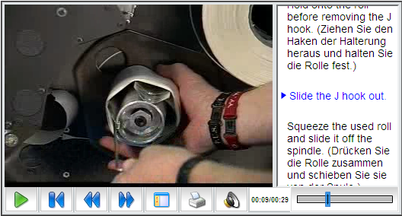

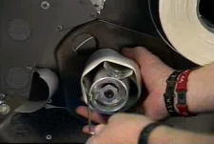
Video can be Standard Work (A “Shipping Container” for Knowledge)
?
?
Easy to pack
Easy to handle
Contents are protected
Self-validating

Slide 12

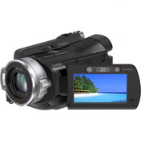
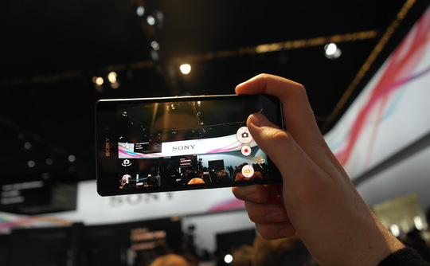
Simple, Standard Capture Tools
Screencast Software ($39)
Make a movie of anything that can happens on a computer screen
Digital Camcorders ($500-$1K)
Hard drive camcorders hold hours of digital video
Smartphone ($100-$600)
Cell-phones with high quality video cameras

Slide 13
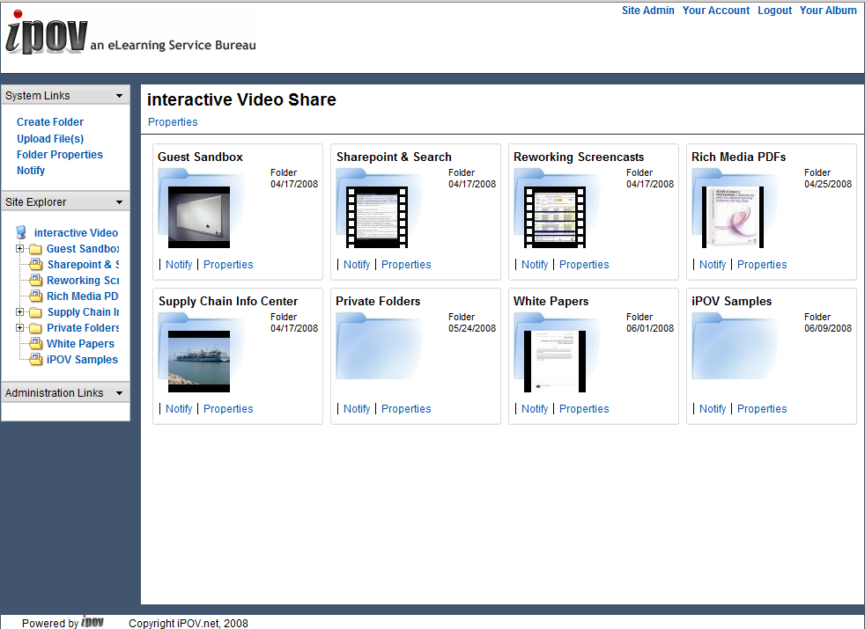
Standard Document/Video Sharing
Upload video, documents, images, audio, files (like YouTube)
Share and organize files and materials
Notify others that new materials are available
View content or download files

Slide 14
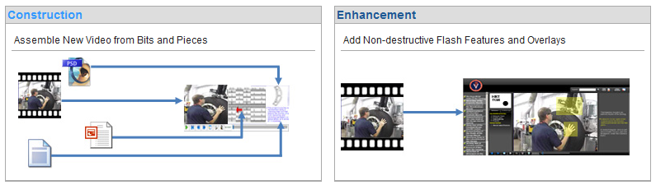
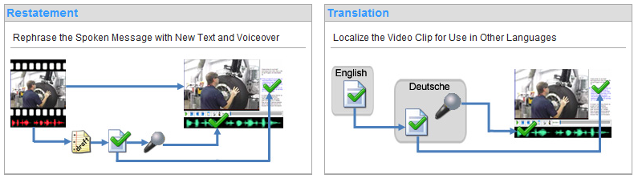
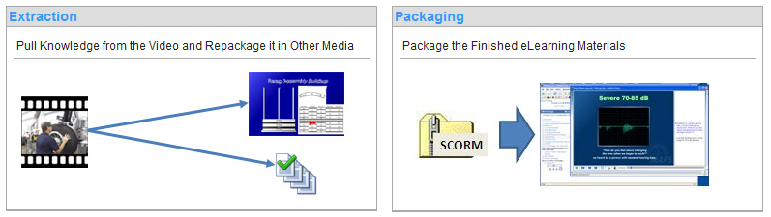
Standard Transformations

Slide 15
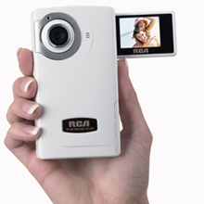

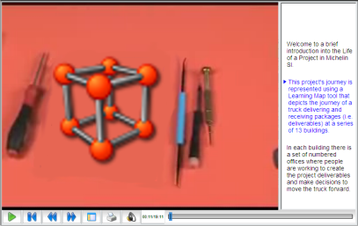
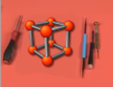



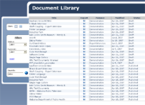



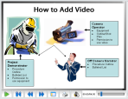




e.g., Restatement
+
iPOV

Slide 16
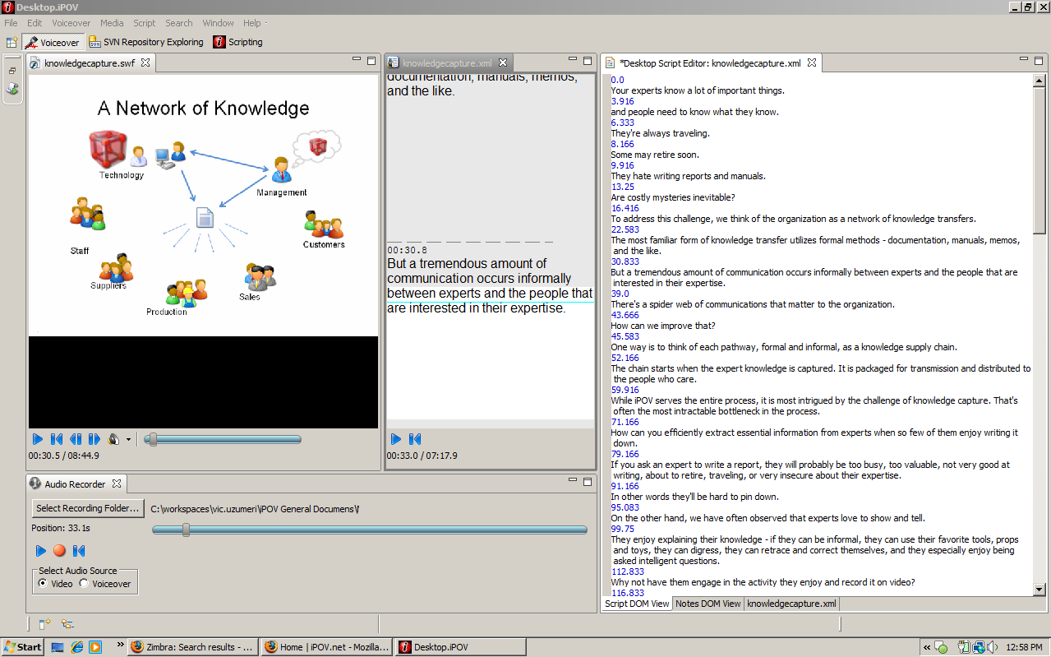
Standard Tools (for restatement and translation)
Transcribe subtitles on server via the Internet
Synchronize subtitles with audio and video
Multilingual
Teleprompter for voiceover
Voice recorder captures audio of new voice
Record, scroll back to mistake, resume – until finished
Desktop.iPOV
Screenshot

Slide 17

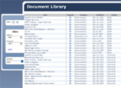

Lean, Modular Processing System
Video Capture
Techniques
Video
Repository
Publishing Techniques
Distribution Techniques

Slide 18
How fast is fast?

Slide 19


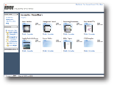



Restating an Engineer’s Explanation (for 2 hrs of video)
script
<1 week
voiceover
<1 week
client review / edit
1 week if needed
upload
Example
2 to 4 wks total elapsed time

Slide 20

Annotating an Engineer’s Video (for 2 hrs of video)
flash annotations
<2 weeks
client review
1 week if needed
upload
Example
2 to 4 wks total elapsed time

Slide 21

Course Repackaging
flash annotations
and scripting
<2 weeks
client review
1 week if needed
upload
Example
Example
2 to 4 wks total elapsed time

Slide 22



PDFs
convert to flash and embed in PDF
PDF & Video
can be stored
in SharePoint
<1 day
Examples
client review/edit
1 week (if needed)
upload
1 to 5 days total elapsed time

Slide 23

Searchable Web Archive
script
<1 week
client review / edit
(optional)
Examples
upload
< 1wk total elapsed time

Slide 24



Video for Troubleshooting
experts review and comment
upload video of problem
archived
solution
Example
as little as a few hours

Slide 25
Cataloging & Communicating
EMail
Example
upload
minutes?

Slide 26
Importance of speed to an ERP Deployment

Slide 27
Stick with Vendor Design
“go live”
current company practice
workforce understanding
vendor’s assumed method
resistance
operational change
Change company operations to fit vendor software.
Train workforce using vendor-supplied materials.
Installation and training is relatively easy
Performance lags as workers resist changes to established work patterns.

Slide 28
Customize Software
“Go Live”
current company practice
familiar operation
customize
confusion due to
poor documentation
vendor’s assumed method
workforce understanding
3 - 6 months
Customize software to fit current operations.
Vendor-supplied training materials are obsolete.
Slow deployment but software fits better with operations .
It takes time to produce training materials that accurately reflect the customizations
Information delays limit workforce performance.

Slide 29
With Lean Authoring of Materials
“Go Live”
current company practice
familiar operation
customization
workforce understanding
vendor’s assumed method
3-6 weeks
Customize software to fit business needs.
Deployment takes longer but fits better
Record and save screencast movies of software as customization progresses
Generate customized training materials in 3 to 6 weeks.
Workforce is trained in time on processes that are more familiar.

Slide 30
broader connections

Slide 31
Complementing Conventional Methods
expert
Instructional Design
Artist can ‘mine’ video objects when expert is not available
‘Rapid’ eLearning
Expert can supplement written material with video
Outsource tedious transformations
Powerful Computer Workstation
tool
artist
tool
tool
tool
tool
tool
tool
tool
tool
tool
tool
tool
expert
facilitator
Powerful Computer Workstation
Rapid Authoring
Software

Slide 32

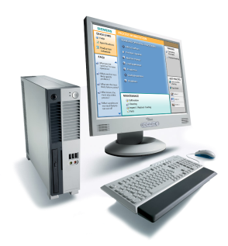
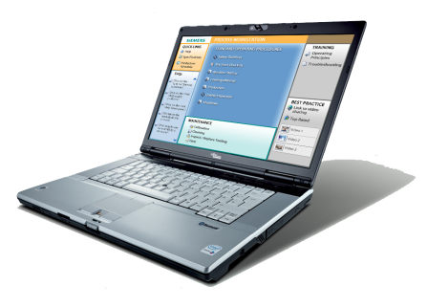
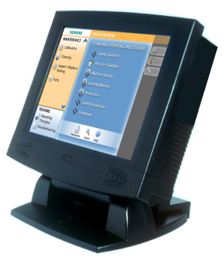
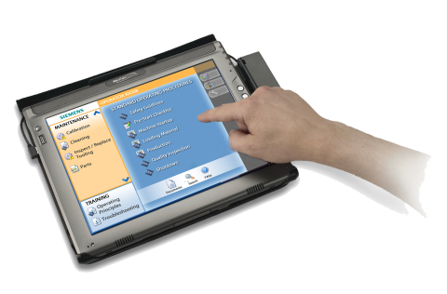
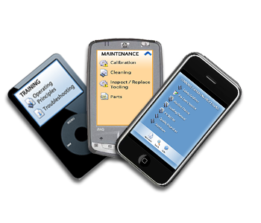
V-POST Network
Siemens/
Corporate
Master Content
Server
in-Plant
Proxy Server
(optional)
Process
Owner’s
Workstation
Engineer’s
Laptop
Touchscreen
Factory Kiosk
Technician’s
Touchscreen
Tablet
Mobile Devices

Slide 33
XML-based Object Models of Technical Documentation
System
SubSystem 1
SubSubSystem 1
SubSubSystem 2
SubSubSystem 2
SubSystem 2
SubSubSystem 1
SubSubSystem 2
SubSubSystem 3
SubSystem 3
SubSubSystem 1
SubSubSystem 2
V
V
V
Reference
V
V
V
Story/Procedure
solution
4
2
V
V
V
1
3
5
issue
V
“see also”
V
V
Search/ Troubleshooting

Slide 34
Documentation Life Cycle
Why would I want it?
1
2
3
4
5
Potential Customer
V
V
What can it do?
2
3
4
5
Novice
1
V
V
V
V
V
solution
But it doesn’t work!
issue
Journeyman
V
V
System
SubSystem 1
SubSubSystem 1
SubSubSystem 2
SubSystem 2
SubSubSystem 1
SubSubSystem 2
SubSystem 3
SubSubSystem 1
SubSubSystem 2
I wonder if
I can _____?
V
Expert
V
V

Slide 35


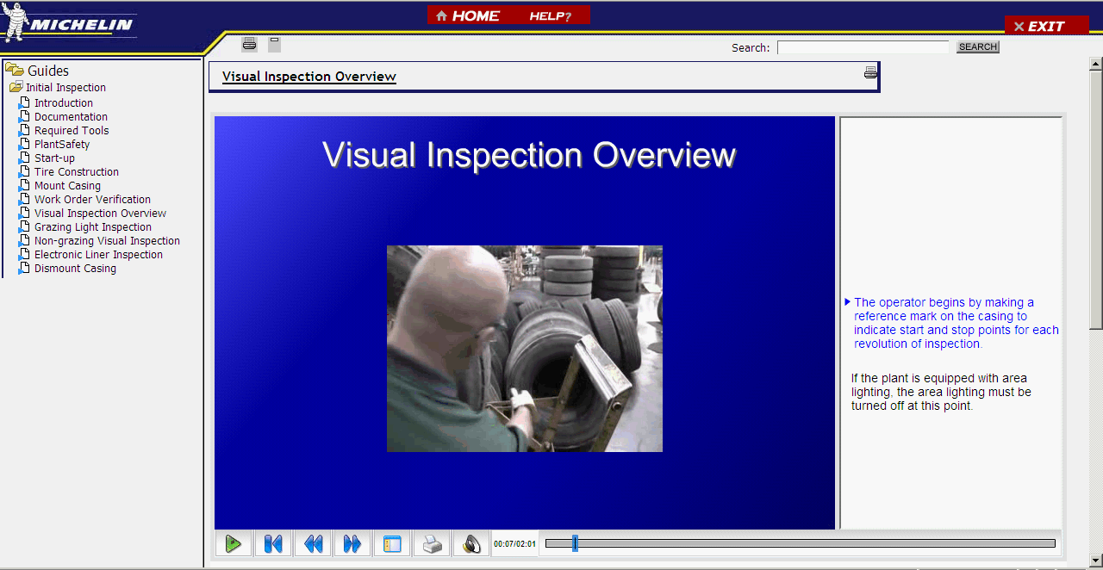


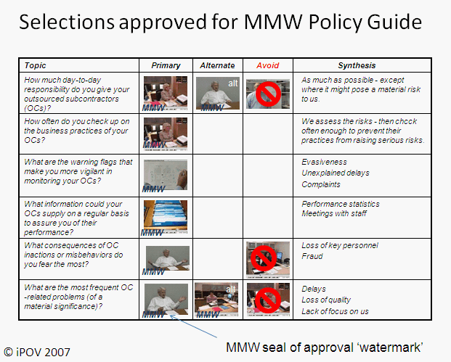
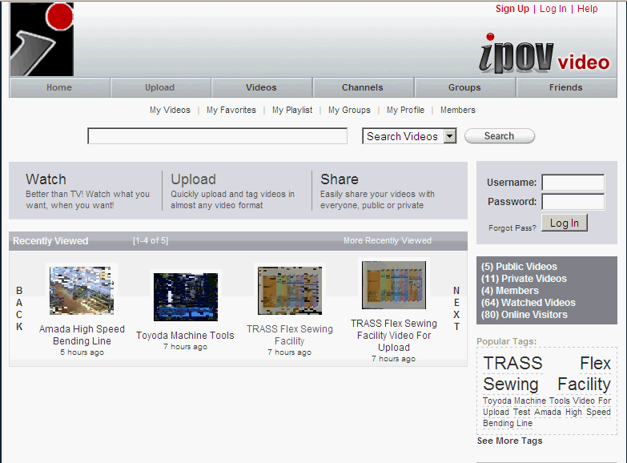

A Video-enabled Tech Support Ecosystem
Retain
Tradition
(expert interview)
Replacements
eLearning
Expert
Interview
Technicians
& Operators
Expert
Foster
Innovation
(video sharing)
Ad Hoc
Video
Formal
Review Process
Structured
Documentation
Video Sharing
(YouTube clone)
Structured
Video +
Metadata
Video Document Publishing
LMS
(e.g., learn.com)
Subject Experts
Reinforce Operational Discipline

Slide 36
Thank YOu

Slide 37
Vic Uzumeri, PhD
Transportation Engineer & MBA
12 yrs engineering and marketing of technical equipment: urban transit, railway operations and wind tunnel control systems
PhD from RPI in management of technology
Studied ‘role of change and variety’ in design and manufacturing
Co-author of book on managing technological product families
Multiple publications on quality, learning, control systems, project management and innovation

Slide 38
Vic Uzumeri, Assoc. Prof.
College of Business, Auburn University
21 years of leading Internet-based eLearning
13 years teaching distance MBA
7 years teaching distance Executive MBA
21 years teaching operations management
Lean manufacturing, lean systems
Service operations and project management
Quality management, ISO 9000, mgmt control systems
Entrepreneurship
Developed Auburn’s Technical Systems Mgmt Minor for non-engineers.
Developed method to teach live remote classes from offices of corporate executives.

Slide 39
Vic Uzumeri, CEO interactive Point of View, Auburn AL
Started in 1995 with projects for Chrysler (Steve Clark)
350+ eLearning projects (e.g., Michelin, DaimlerChrysler, Synovus)
Software deployment training (e.g., Oracle, PeopleSoft)
Plant floor operations (operators, maintenance)
Eliciting knowledge from retiring experts
Lean processes for authoring, production, and distribution of technical knowledge
Original eLearning technology
web-based client-server for revision and language translation of video eLearning
Online portal and search engine for video-enhanced technical eLearning.
Flexible, high performance Flash video playlist controller for eLearning content
Low-cost, searchable video format for capturing and retrieving expert knowledge
Online XML-based eLearning design and production system

